Slide 1

PROJECT PRESENTATION
ION THRUSTER
ION-3D: NEXT-GEN MINI THRUSTER FOR AGILE SATELLITE PROPULSION
BY :-
Arupya T
Ashwini Sai KS
Athulya A
Swanand Kasar
TEAM MENTOR
Mr. Ezhilarasu R
Assistant Professor
Dept. Of Aero & Aerospace

Slide 2
ABSTRACT
Our project develops a compact, cost-effective ion thruster to enhance in-space mobility and orbital adjustments for CubeSats and mini-satellites. By integrating a 3D-printed convergent nozzle, we improve thrust efficiency through focused ion acceleration. Additive manufacturing enables rapid prototyping with high precision and minimal waste. For large-scale use, the nozzle is made from carbon fiber-reinforced PEEK (CF-PEEK), while Nylon 6 is used for low-cost, small-scale prototypes. Supported by advanced simulations, this thruster advances sustainable and responsive space technologies.

Slide 3
DOMAIN DESCRIPTION (for Ion Thruster with Convergent Nozzle)
Electric Propulsion Systems
  Focuses on using electrical energy to accelerate charged particles (ions) and produce thrust for spacecraft.
  Provides high efficiency, low fuel consumption, and is ideal for deep-space and satellite missions.

Slide 4
PROBLEM STATEMENT
  Typical ion thrusters are too large, expensive, and complex for small satellites.
  CubeSats often lack propulsion, limiting maneuverability and mission lifespan.
  There is a need for a miniaturized, affordable, and efficient ion thruster solution.

Slide 5
OBJECTIVES
  Design a mini-ion thruster for small satellites.
  Develop a 3D-printed convergent nozzle (Nylon 6 prototype).
  Validate design through simulation and experimental testing.
MOTIVATION
  Increasing demand for low-cost, lightweight satellite propulsion.
  Miniaturization is key for next-gen space missions.
  Leverage additive manufacturing to achieve cost efficiency and flexibility

Slide 6
THEORY OF ION THRUSTER WITH CONVERGENT NOZZLE
ION THRUSTER
  An electric propulsion system using ions to generate thrust.
  Highly efficient for long-duration space missions.
WORKING PRINCIPAL OVERVIEW
  Ionization of Propellant: Neutral gas (e.g., xenon) is ionized using a high-voltage electrode.
  Acceleration of Ions: Ions are accelerated by an electrostatic field to high speeds.
  Convergent Nozzle: The ions are passed through a convergent nozzle, further accelerating them and generating thrust.
  Neutralization: Electrons are introduced to neutralize the ion beam and maintain electrical neutrality.

Slide 7
THEORY OF ION THRUSTER WITH CONVERGENT NOZZLE
Working Process:
  Ionization: Propellant is ionized, creating positively charged ions.
  Acceleration: Ions are accelerated by a high-voltage electric field.
  Thrust Generation: The convergent nozzle increases the velocity of the ions, creating thrust (Newton's Third Law).
  Neutralization: A cathode neutralizer emits electrons to neutralize the ion flow.
Efficiency:
  High Specific Impulse (Isp): Ion thrusters are more fuel-efficient than traditional chemical rockets, ideal for long-term space missions.

Slide 8
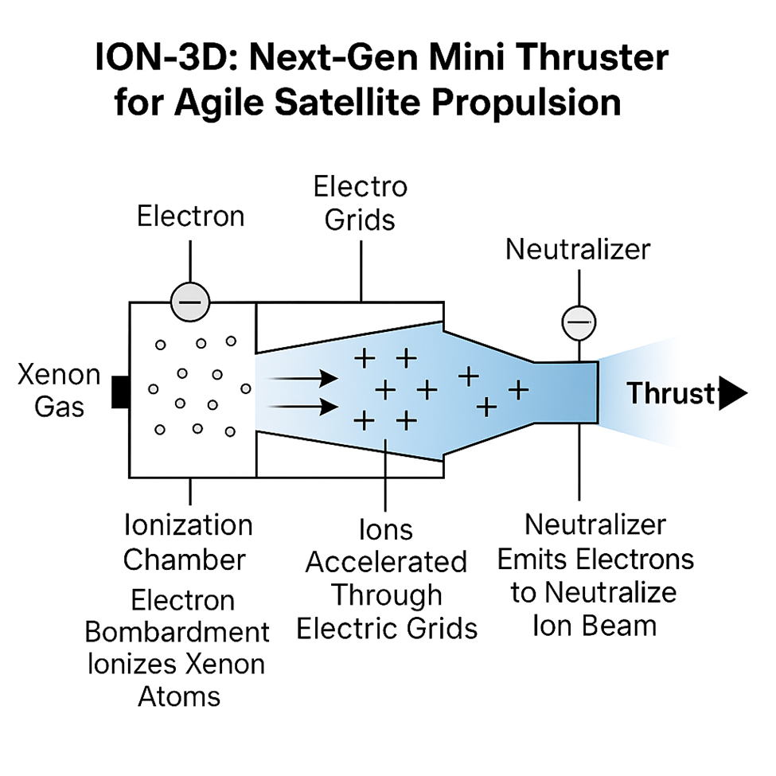
ION Thruster

Slide 9
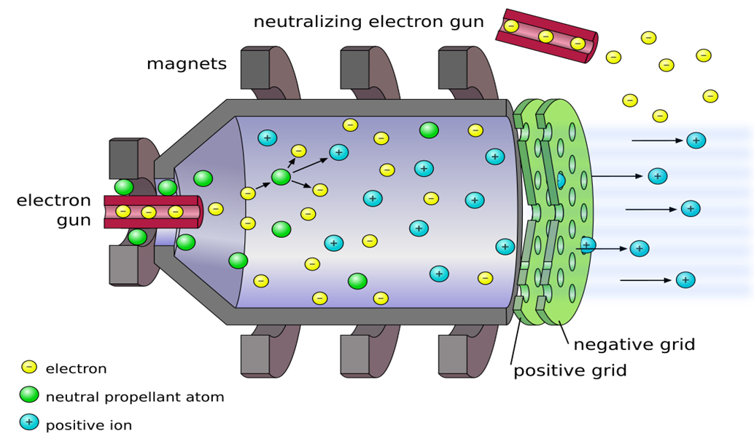
ION Thruster

Slide 10
INNOVATION IN 3D-PRINTED ION THRUSTER NOZZLE
1. Innovation
✅ Dual-Material Strategy:
  Nylon 6 (for small-scale, low-cost prototyping).
  CF-PEEK (for high-temperature, space applications).
✅ 3D Printing Integration:
  Lightweight, faster manufacturing, and low material waste.
2. How It Will Be Useful?
Cost-Effective: Nylon 6 for early-stage testing, CF-PEEK for real missions, reducing overall costs.
Faster Prototyping: 3D printing speeds up development, unlike traditional materials requiring molding or machining.
Weight Reduction: Lighter than metal & ceramics, improving fuel efficiency in space.

Slide 11
MATERIAL SELECTED
Materials Used:
  Nylon 6 — for Prototype Fabrication
  CF-PEEK — for Simulation and Future Space Applications
Property | Nylon 6 (Prototype) | CF-PEEK (Space Use)
Thermal Resistance | ~180°C (moderate) | >250°C (excellent)
Strength | Good | Very High
Cost | Low (affordable) | High (premium aerospace -grade)
Ease of Printing | Easy (FDM 3D Printers) | Difficult (needs industrial printer)
Application | Lab testing and experiments | Space operational conditions

Slide 12
PEEK & Nylon 6 vs Other Nozzle Materials
Feature | CF-PEEK & Nylon 6 (3D-Printed) | Ceramic | Metal (Inconel 718) | Graphite
Cost | ✅ Low (₹600-₹24,000) | ❌ High (₹40,000+) | ❌ Very High (₹70,000+) | ❌ Moderate
Manufacturing Time | ✅ Fast (6-12 hrs) | ❌ Slow (Sintering takes weeks) | ❌ Slow (Machining takes weeks) | ❌ Moderate
Weight | ✅ Lightweight | ❌ Heavy | ❌ Very Heavy | ✅ Lightweight
Durability | ✅ PEEK: High, Nylon 6: Moderate | ✅ Very High but brittle | ✅ Extremely High | ❌ Moderate (Erosion issues)
Thermal Resistance | ✅ PEEK: 343°C, Nylon 6: 220°C | ✅ Ceramic: 1200°C+ | ✅ Inconel: 1100°C+ | ❌ Graphite: 600-800°C
Suitability for 3D Printing | ✅ Excellent | ❌ Limited | ❌ Difficult | ✅ Possible but costly

Slide 13
INNOVATION IN 3D-PRINTED ION THRUSTER NOZZLE
Why (CF-PEEK & Nylon 6) is the Best Choice?
✅ Cost-Effective: Cheaper than metal & ceramic while maintaining good performance.
✅ Fast Production: 3D printing reduces manufacturing time, unlike ceramics & metals.
✅ Good Thermal Resistance: PEEK handles high temperatures well, making it suitable for space missions.
✅ Lightweight: Lower mass → More efficient propulsion in spacecraft.

Slide 14
Prototype Development Process for 3D-Printed Ion Thruster Nozzle
Step 01 - Material Selection & Equipment Preparation
Step 02 - Nozzle Design & Simulation (Fusion 360)
Step 03 - 3D Printing of the Nozzle
Step 04 - Graphite Coating on Nylon 6 Nozzle
Step 05 - Electroplating with Copper Sulphate Powder
Step 06 - Assembly of the Thruster System
Step 07 - Testing, Calibration & Performance Analysis

Slide 15
NOZZLE DIMENSIONS
PARAMETERS | DIMENSIONS
NOZZLE INLET DIAMETER (DI) | 48 mm
NOZZLE OUTER DIAMETER (DO) | 30 mm
OVERALL NOZZLE LENGTH (L) | 25 mm
WALL THICKNESS | 2 mm

Slide 16
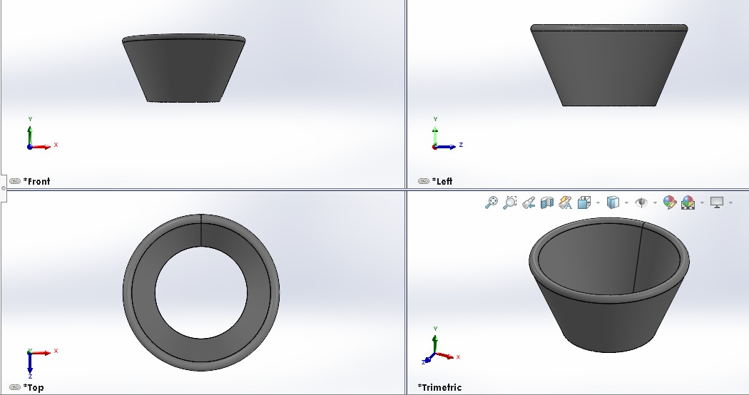
NOZZLE DESIGN PART

Slide 17
NOZZLE SIMULATION
The analysis was divided into two key parts:
· Mass Flow Inlet Simulation (to assess aerodynamic performance)
· Thermal Analysis (to evaluate heat distribution and material stress)
These simulations are crucial for ensuring both the thrust efficiency and material integrity of the nozzle under realistic working environments.

Slide 18
NOZZLE SIMULATION - MASS FLOW INLET
Objective:
Evaluate aerodynamic behavior of ion thruster nozzle
Verify ability to accelerate compressible flow to generate thrust
Simulation Setup:
Software: ANSYS Fluent 2024 (3D, steady)
Solver: Density-based, SST k-ω turbulence model
Heat Transfer: Disabled (aerodynamic-only)
Solver: Density-based, SST k-ω turbulence model
Heat Transfer: Disabled (aerodynamic-only)

Slide 19
NOZZLE SIMULATION - MASS FLOW INLET
Mesh Details:
Cells: 125,274 | Nodes: 442,624
Min Orthogonal Quality: 0.157
Max Aspect Ratio: 52.63
Material Properties:
Fluid: Ideal Air (Sutherland law)
Wall: Aluminum (CF-PEEK unavailable in Fluent)
Boundary Conditions:
Inlet: 0.126 kg/s, 298 K, 5% turbulence
Outlet: Gauge Pressure = 0 Pa
Walls: No-slip, adiabatic

Slide 20
NOZZLE SIMULATION - MASS FLOW INLET
Solver Settings:
Second Order Upwind, Courant No: 5, Steady
Converged in 400 iterations
Key Results:
Outlet Velocity: 146.65 m/s
Mass Flow Residual: ~0.00013 kg/s
Smooth acceleration, proper pressure drop
Mach number transition to near-sonic at outlet

Slide 21
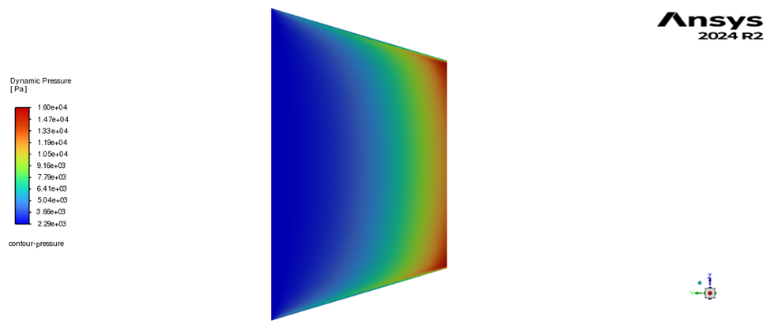
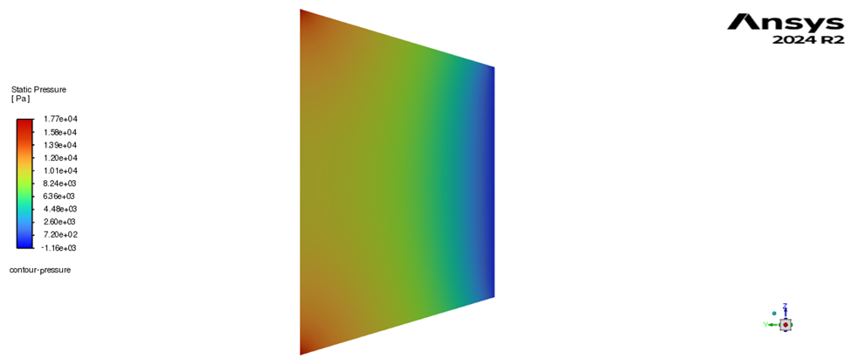
NOZZLE SIMULATION - MASS FLOW INLET
Pressure Dynamic
Pressure Static

Slide 22
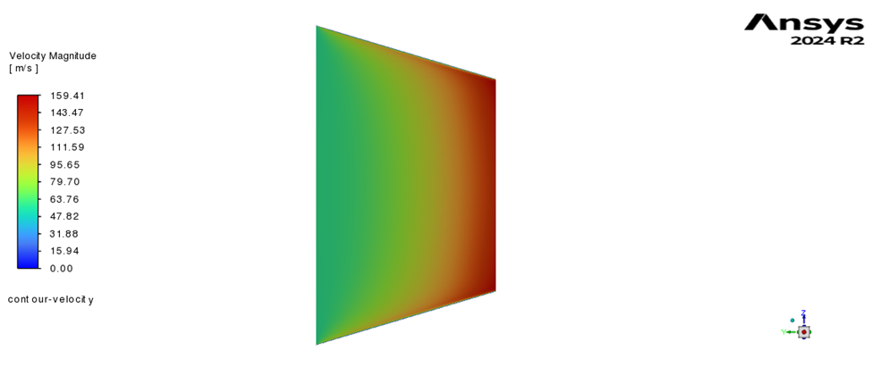
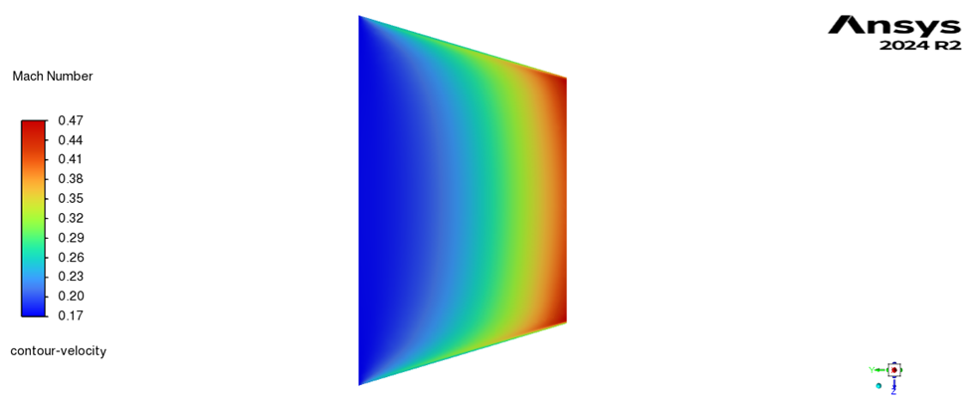
NOZZLE SIMULATION
Velocity Magnitude
Velocity Mach Number

Slide 23
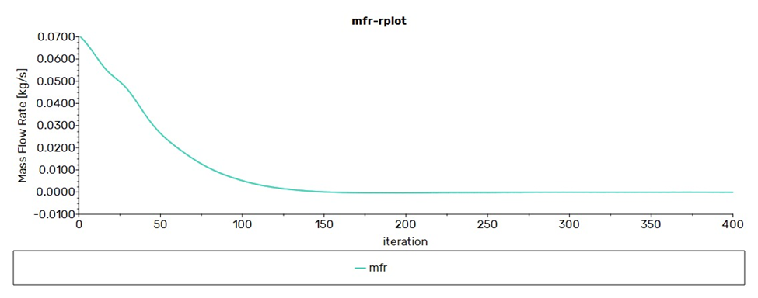
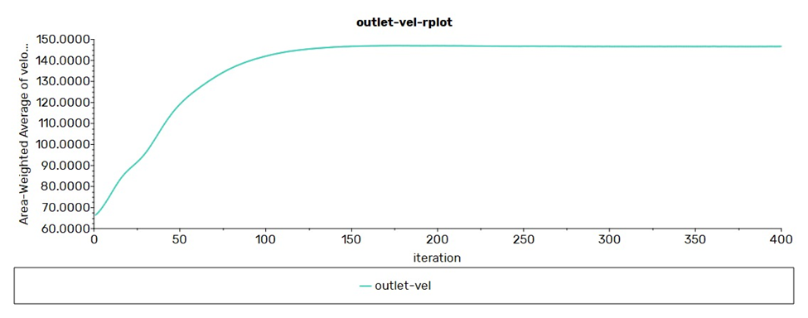
Mass Flow Rate vs Iteration
Outlet Velocity vs Iteration

Slide 24
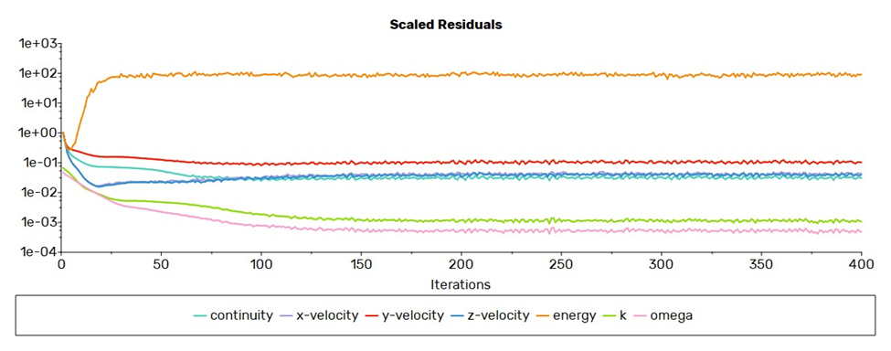
Scaled Residuals (Continuity, Velocities, Energy, k, ω)

Slide 25
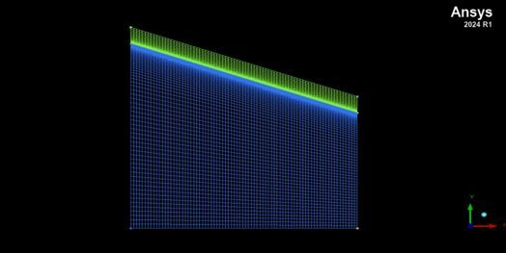
Thermal Analysis of Ion Thruster Nozzle – ANSYS Fluent
Objective:
To analyze the wall temperature and heat transfer behavior of the nozzle using CF-PEEK material under steady-state flow of xenon gas.
Simulation Setup:
Solver: Pressure-based, Steady, 2D Axisymmetric
Models: Energy Equation ON, SST k-ω Turbulence
Materials:
Fluid: Xenon (Ideal Gas)
Solid: CF-PEEK
Meshing:
Type: Structured Quad Mesh
Refinement: Finer mesh near the wall for accurate thermal capture
Structured Mesh of Nozzle Domain

Slide 26
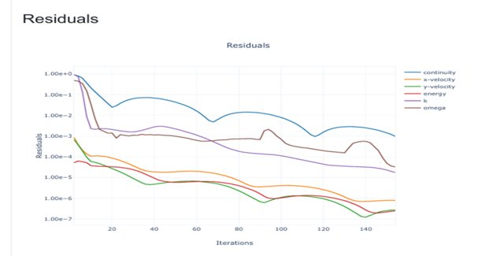
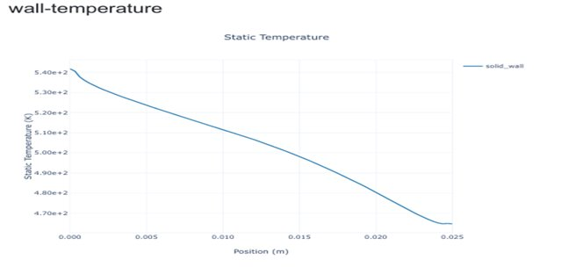
Boundary Conditions and Solver Convergence
Boundary Conditions:
Inlet:
Mass Flow Rate: 0.126 kg/s
Temperature: 573 K
Outlet:
Pressure: 0 Pa (ambient)
Wall:
Coupled fluid–solid interface for conjugate heat transfer
Residuals Vs Iterations
Solver Info:
Initialization: Hybrid
Convergence: Achieved in 77 iterations
Wall Static Temperature Vs Axial Position

Slide 27
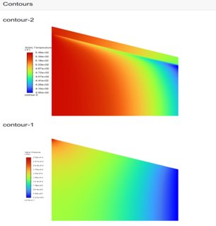
Contour Visualization and Output Analysis
Contour Visualizations:
Key Outputs:
Max Wall Temperature: ~533 K
Outlet Velocity: 146.65 m/s
Material Check: CF-PEEK performs within safe thermal limits
Conclusion:
Simulation validates nozzle’s thermal performance.
CF-PEEK is suitable for expected operating temperatures .
Nozzle design is thermally efficient for ion propulsion .
1. Static Temperature Contour: 2. Velocity Magnitude Contour

Slide 28
MATERIAL COST STRUCTURE
Material & 3D Printing Cost for Small-Scale 3D-Printed Ion Thruster Nozzle (Nylon 6) – INR
Item | Cost (Rs.)
Transformer | 345
Li ion | 600
Nylon 6 | 500
3D Printer (Rental/Making) | 1500
Copper Strip | 220
Soldering Items | 80
Item | Cost (Rs.)
Wires | 50
Copper Sulphate Powder | 300
Electroplating Process | 100
Carbon Powder | 80
Total Cost | 3,775

Slide 29
MATERIAL COST STRUCTURE
Material & 3D Printing Cost for Large-Scale 3D-Printed Ion Thruster Nozzle (PEEK) – INR
Item | Cost (Rs.)
Transformer | 345
Li ion | 600
PEEK | 2000
3D Printer (Rental/Making) | 1500
Copper Strip | 220
Soldering Items | 80
Item | Cost (Rs.)
Wires | 50
Copper Sulphate Powder | 300
Electroplating Process | 100
Carbon Powder | 80
Total Cost | 5,275

Slide 30
EQUIPMENTS / MATERIALS NEEDED
  Transformer
  Lithium Ion Battery
  Nylon 6 Filament
  3D Printer
  Copper Strip
  Soldering Items
  Wires
  3D Printed Nozzle

Slide 31
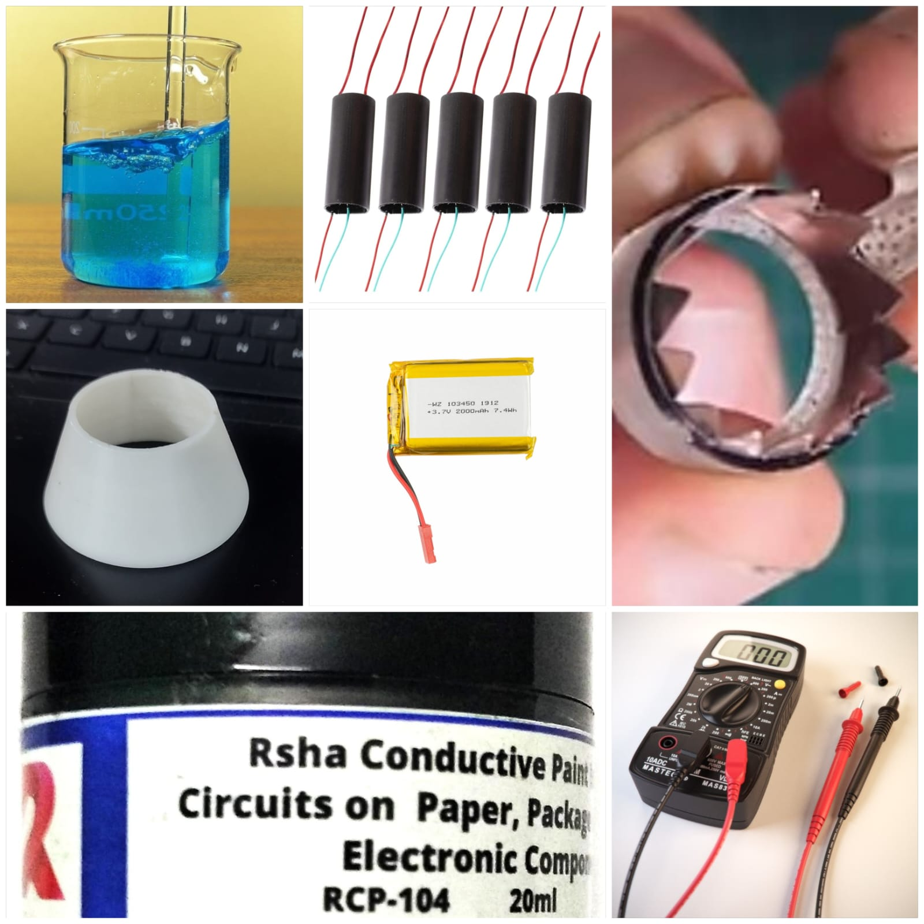

Slide 32
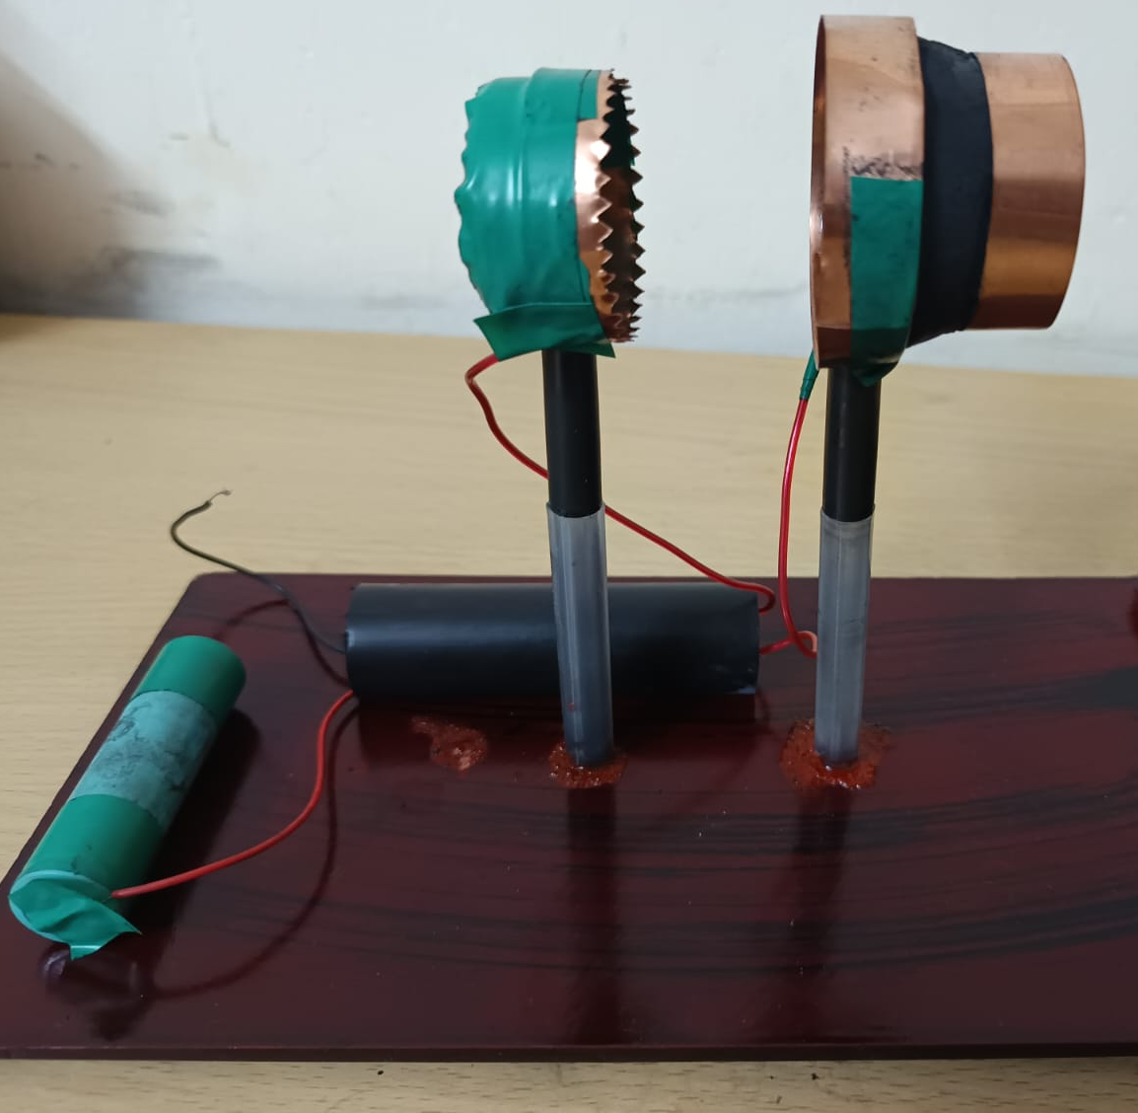
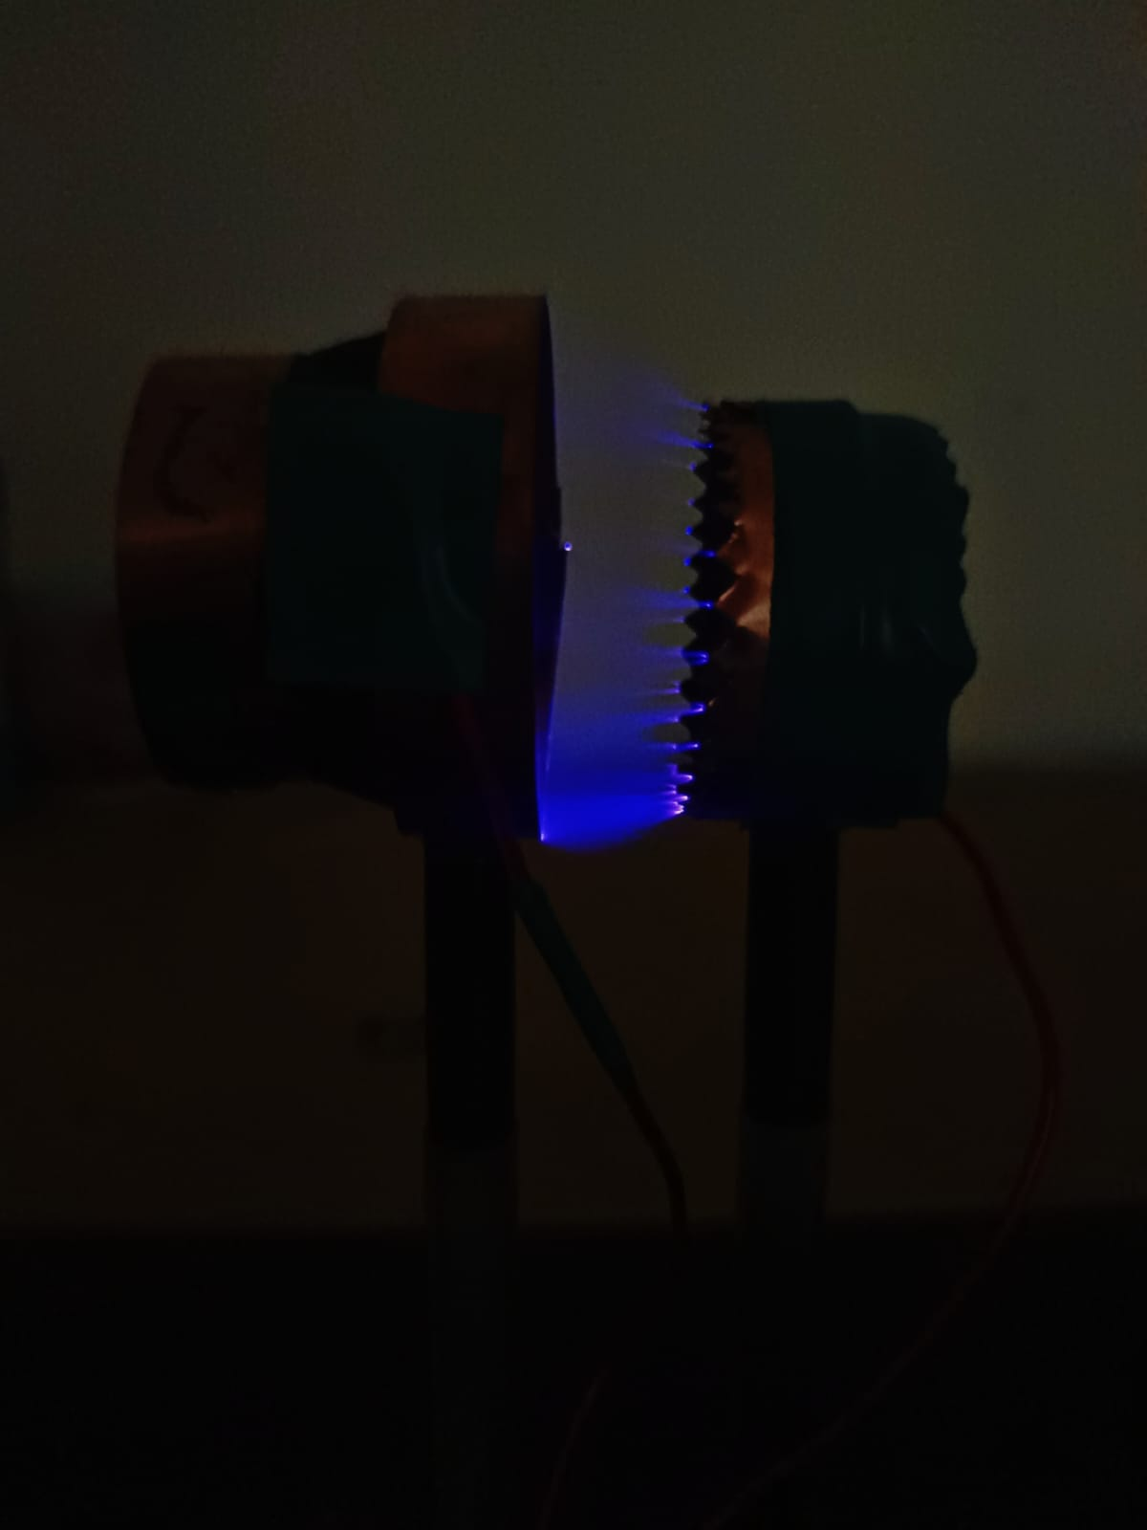
EXPERIMENTAL TESTING SETUP

Slide 33
How this differs from Others?
  Typical Ion Thrusters: Large, bulky, expensive for small satellites.
  3D Printing Approach: Creates a compact, affordable alternative that can be integrated into small-scale satellites
What are the Special Features?
  Compact and Lightweight: Ideal for small spacecraft.
  Cost-Effective: Using 3D printing reduces production and material costs.
  Custom Design: Optimized for better ionization and propulsion efficiency.

Slide 34
Future Prospects
  Miniaturization: Potential to scale ion thrusters for smaller, more efficient satellites.
  Sustainability: Reduced fuel needs and longer operational lifespan compared to traditional propulsion systems.

Slide 35
Conclusion
Summary:
This project focuses on modifying a 3D printer nozzle to create a compact, cost-effective ion thruster for small satellites using Nylon 6 and 3D printing.
Future Work:
Future phases will optimize the design and conduct performance testing for effective ion propulsion.

Slide 36
THANK YOU !
TEAM MENTOR
TEAM MEMBERS
Mr. Ezhilarasu
Arupya T- (21AO08)
Ashwini Sai K S- (21AO09)
Athulya A- (21AO14)
Swanand Kasar - (21AO35)

